Slide 1
FINAL PROJECT
BASIC DATABASE
Group 8
Đoàn Văn Chương Ba9-008 Đoàn Đình Nam Ba9-045 Nguyễn Văn Cường Ba9-011 Đặng Hoàng Phúc Ba9-050 Đào Hải Long Ba9-041

Slide 2






TIMELINE
Introduction
User requirements
ERD
Database schema
Implementation
Database structure

Slide 3
Introduction
The title of the project is: “Blog management system”
The main target is:
- Bloggers can be individuals or a small group, express their subjective view of a certain topic, write about things they like
Explore the opportunities and the conditions that could lead into building a successful system

Slide 4
User Requirements
1. The administrators
Upload new information to the blog and its information including name, content (what to write about), status (ongoing or completed).
Upload a new content, information of the blog.
Track views and reader comments about the blog.
Delete a blog or a blog's information.
2. Users account
Basic information about the reader such as email account
Readers can rate the blog they have read on a scale of 1 star to 5 stars.
Readers can create or delete personal comments.
Readers can change or delete any information about personal accounts.

Slide 5
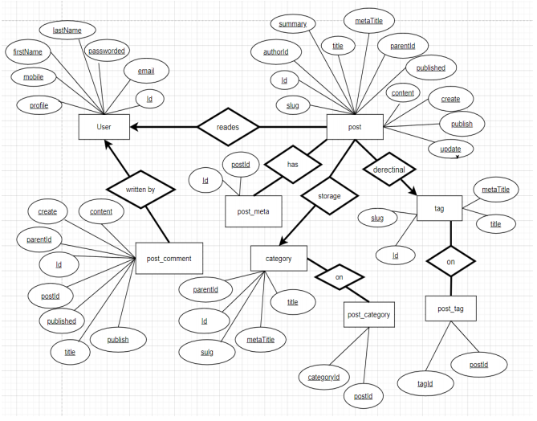
ERD

Slide 6
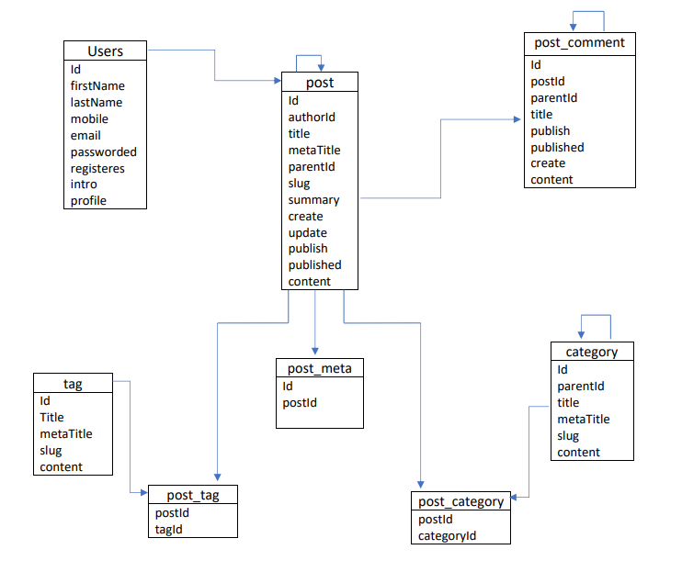
Data Schema

Slide 7
Implementation
Create Database table
Insert and Update Database
Delete commands

Slide 8
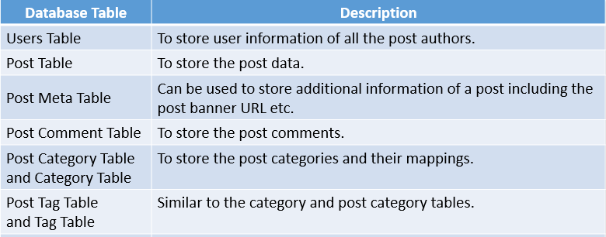
Database Structure

Slide 9


